Slide 1

Troubleshooting Boot Issues of RHEL
Community
Not Just Skill Training
Enabling environment and scope to grow a career
PRESENTED BY: CloudnLoud Team
Notes:
1

Slide 2


Booting process of Linux
01
Our Main Agenda
02
Differences of RHEL 6 7 8
03
Different booting modes
Grub file corrupted of misconfigured
04

Slide 3
MBR corrupted or Missing
05
Our Main Agenda
06
Control D Error
07
Kernel Panic
Initramfs Missing
08

Slide 4
Critical files are Misssing
09
Our Main Agenda
Our Main Agenda

Slide 5

ABOUT US
Cloudnloud was started 11 years back with an intention of up-skilling and up-scaling all our members on the technical front with niche topics around Cloud, DevOps, Data, AI and much more.
Cloudnloud was started by a cancer survivor since Jan 2011. I am helping the tech community and Cancer Children for the past 2 decades to loud from their own confidence in the IT industry. Officially registered as Pvt. Ltd. in Jan-2015, to extend help to cancer children from its revenue. Today Cloudnloud is living that dream with 8973+ cancer children survivors.
“AIMING to Save 2 million cancer children by 2030”

Slide 6
Cloudnloud Tech Community
Cloudnloud tech community started 11 years back with an intention of up-skilling and up-scaling all our members on the technical front with the niche topics around Cloud Computing.
Cloudnloud Tech Community platform focusing on the below-mentioned areas in the coming months to make sure IT professionals are getting more confidence from their existing small skills.
✅ Woman empowerment - Multiple upliftment technology programs.
✅ Cloud Native Solutions and Re-Engineering.
✅ Opensource Re-Engineering Initiatives
✅ Security Re-engineering
✅ Career Related Programs.
✅ College student's programs till they get job
✅ Architecture brainstorm postmortem reviews
✅ Certification Assistance - Fail/Try in own lab POCs
✅ AI Robotics Re-Engineering
✅ Connecting all open source tools to Companies and IT professionals via real-time UseCases.
✅ Technology Training with hands-on use cases

Slide 7

About Me
"I am a highly skilled IT professional with 8 years of experience in Linux administration, scripting, and automation.
Technology Enthusiast who loves learning by doing and believes in constant upskilling.
SANJAY SURWASE
https://www.linkedin.com/in/sanjaystack

Slide 8
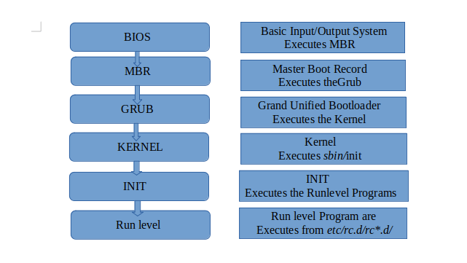
Booting Process of Linux

Slide 9
Booting Process of Linux
Post-
Power-On Self-Test to check hardware components.
2. BIOS
-Basic Input/Output system searches for a boot device according to the boot order configured in the firmware settings.
3. MBR - Master Boot Record
Structure of the MBR: The MBR consists of 512 bytes of data and is divided into three main components:
Bootloader 446
Partition Table 64 bytes
Partition Validation 6

Slide 10
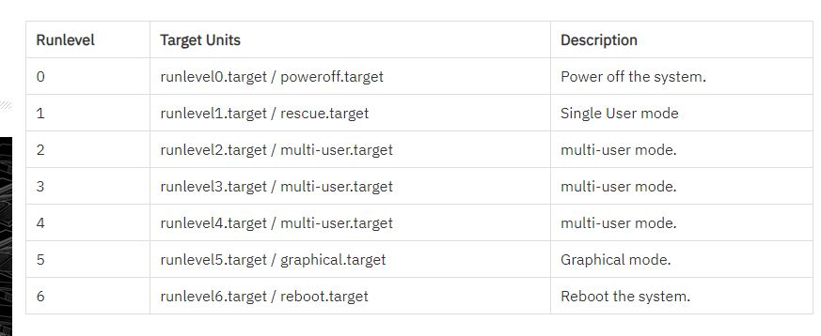
Booting Process of Linux
GRUB:- Grand Unified Boot loader
Stage 1
Stage 1.5
Stage 2
4. Kernel
Init
Runlevel

Slide 11
Different booting modes
Emergency Mode:-
Troubleshooting Mode
Rescue Mode:
systemd.unit=resue.target + press control+x
systemd.unit=emergency.target

Slide 12
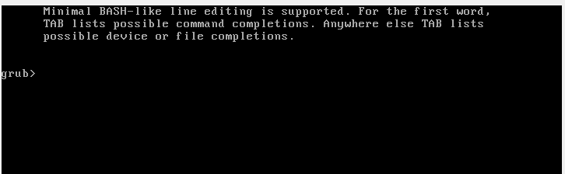
Grub file corrupted of misconfigured
/boot/grub2/grub.cfg ====) Auto generated GRUB Configuration File
/etc/grub.d ===) GRUB Template Directory which contains other grub template files.
/etc/default/grub ===) GRUB Settings File
To regenerate GRUB Configruation File with changed settings from /etc/default/grub use below command

Slide 13
Grub file corrupted of misconfigured
# cat /boot/grub2/grub.cfg
#rm -rf /boot/grub2/grub.cfg
#reboot
#chroot /mnt/sysroot
# lsblk
#grub2-install /dev/sda
#grub2-mkconfig -o /boot/grub2/grub.cfg

Slide 14
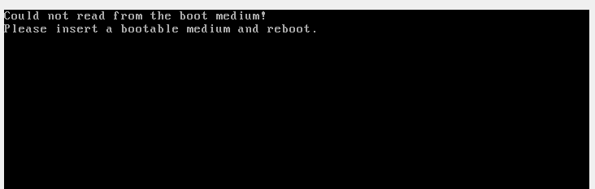
MBR corrupted or Missing
dd if=/dev/zero of=/dev/sda bs=446 count=1
#chroot /mnt/sysroot
# lsblk
#grub2-install /dev/sda
#grub2-mkconfig -o /boot/grub2/grub.cfg

Slide 15
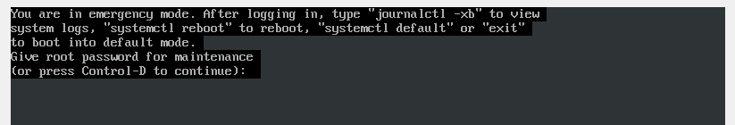
Control D Error
This issue when something went wrong in fstab

Slide 16
Kernel Panic
What is kernel Panic ?
How to deal with kernel panic issue ?
What are the best practices to avoid kernel panic situation.

Slide 17
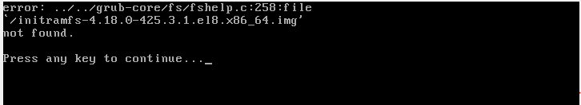
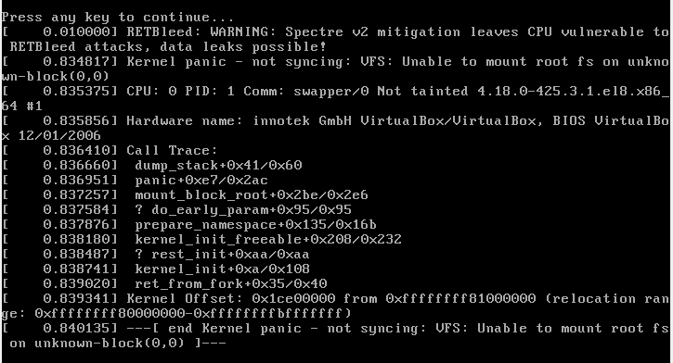
Initramfs Missing
The reason of getting this error. If it is due to new kernel, then downgrade it. If it is due to corrupted or missing initramfs, regenerate it.

Slide 18
Initramfs Missing
rm -rf initramfs-4.18.0-425.3.1.el8.x86_64.img
cd /boot/
uname -r
dracut initramfs-4.18.0-425.3.1.el8.x86_64.img 4.18.0-425.3.1.el8.x86_64
in corrupted situation
cd /boot/
dracut -f initramfs-4.18.0-425.3.1.el8.x86_64.img 4.18.0-425.3.1.el8.x86_64
OR
# mkinitrd --force initramfs-4.18.0-425.3.1.el8.x86_64.img 4.18.0-425.3.1.el8.x86_64

Slide 19
Critical files are missing
/bin/mount is missing
Boot server in resue mode
Chroot /mnt/sysroot
mkdir /mnt/source
Mount /dev/sr0 /mnt/source
Cd /mnt/source
Cd packages/
rpm –ivh packagename

Slide 20
THANK YOU

